Slide 1
Docker + Kubernetes
Mac Chiang

Slide 2
Container History
1979 — chroot
2000 — FreeBSD Jails
2001 — Linux VServer
2004 — Solaris Containers
2005 — OpenVZ
2006 — Process Containers
2007 — Control Groups
2008 — LXC
2011 — Warden
2013 — LMCTFY (Let Me Contain That For You)
2013 — Docker
2014 — Rocket
2016 — Windows Containers
Source: https://dzone.com/articles/evolution-of-linux-containers-future

Slide 3
Shipping code to the server is too hard.

Slide 4
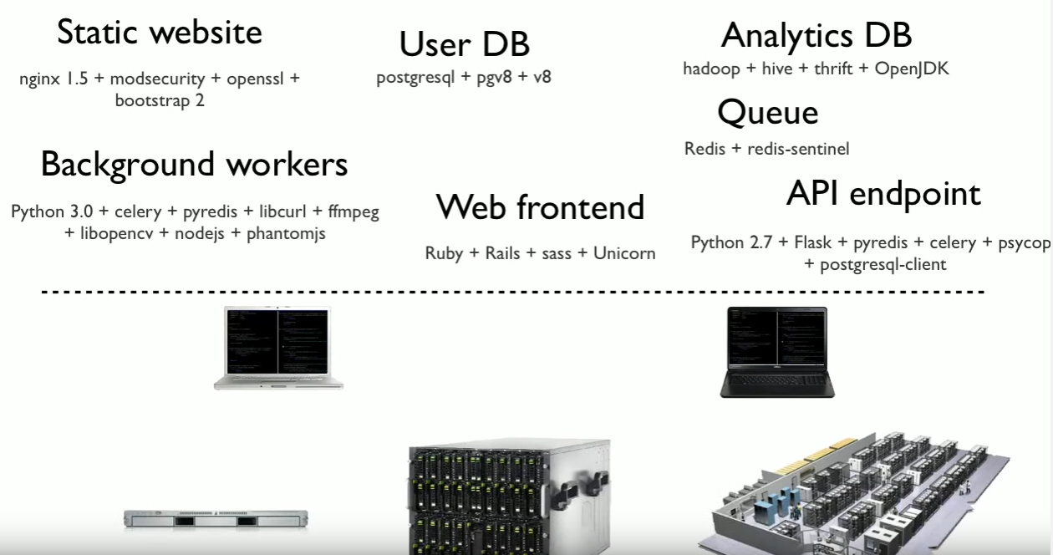
https://www.docker.com

Slide 5
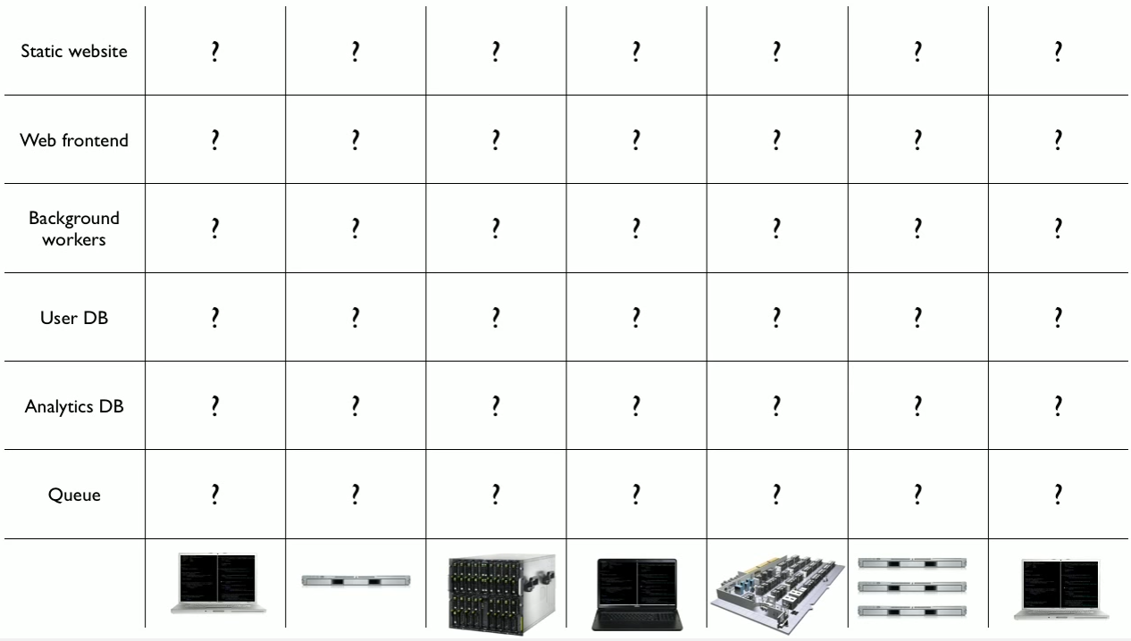
https://www.docker.com

Slide 6
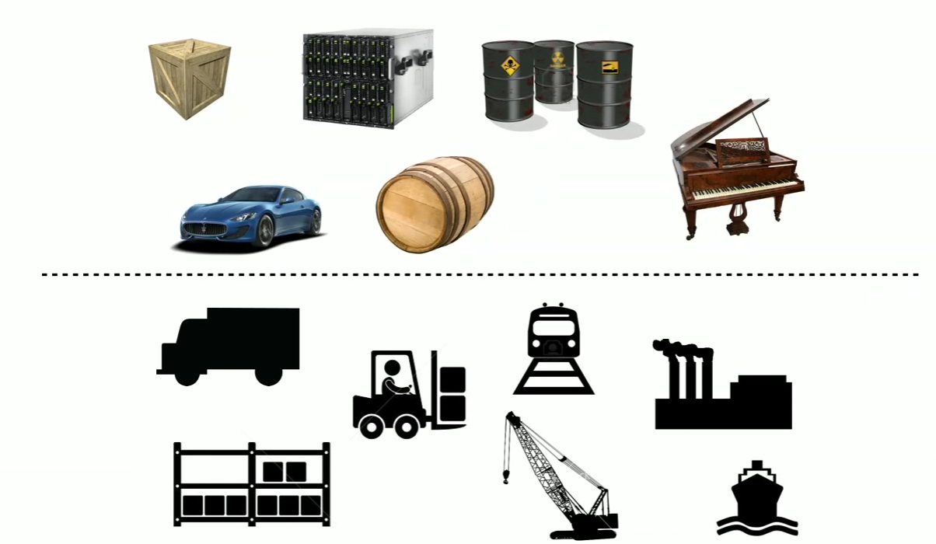
https://www.docker.com

Slide 7
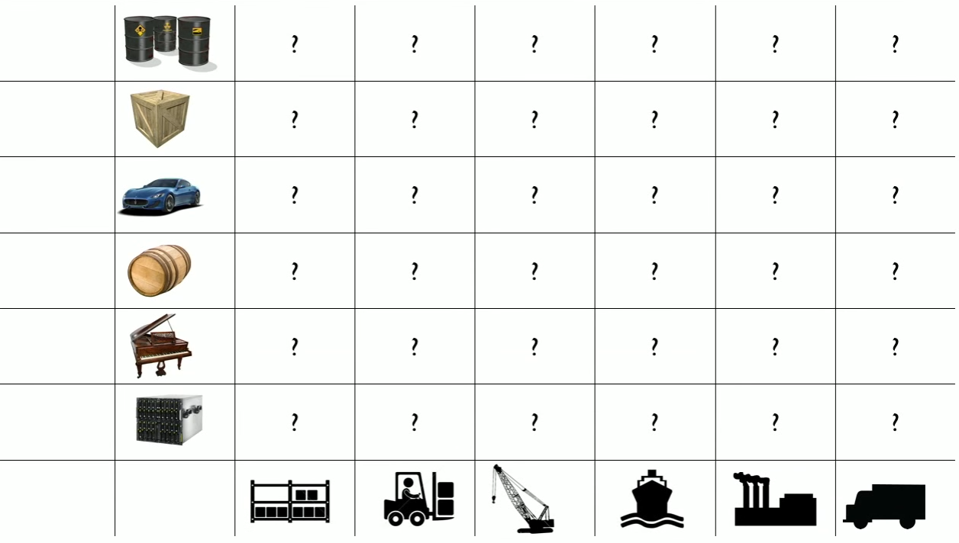
https://www.docker.com

Slide 8
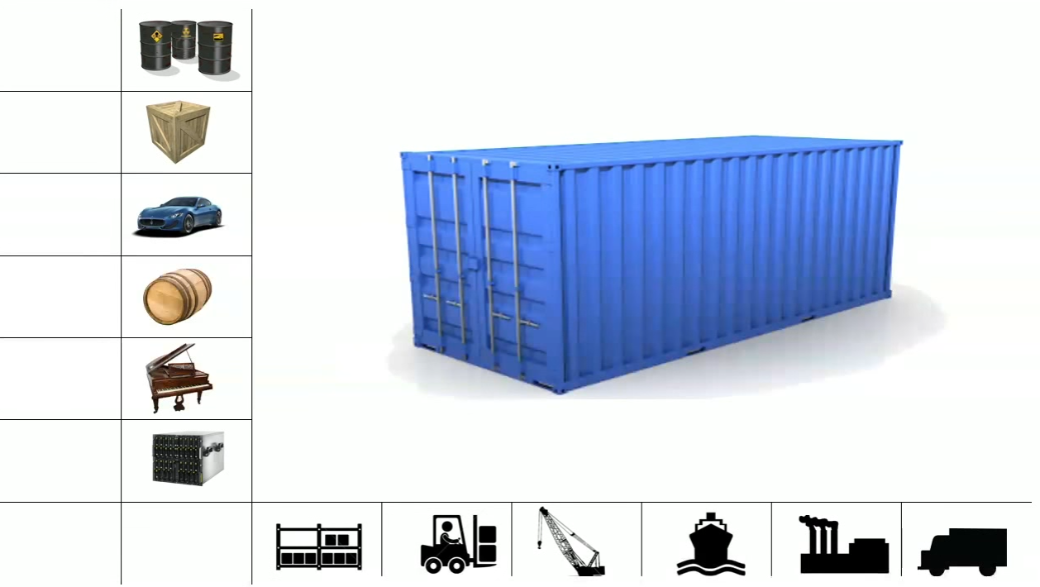
https://www.docker.com

Slide 9
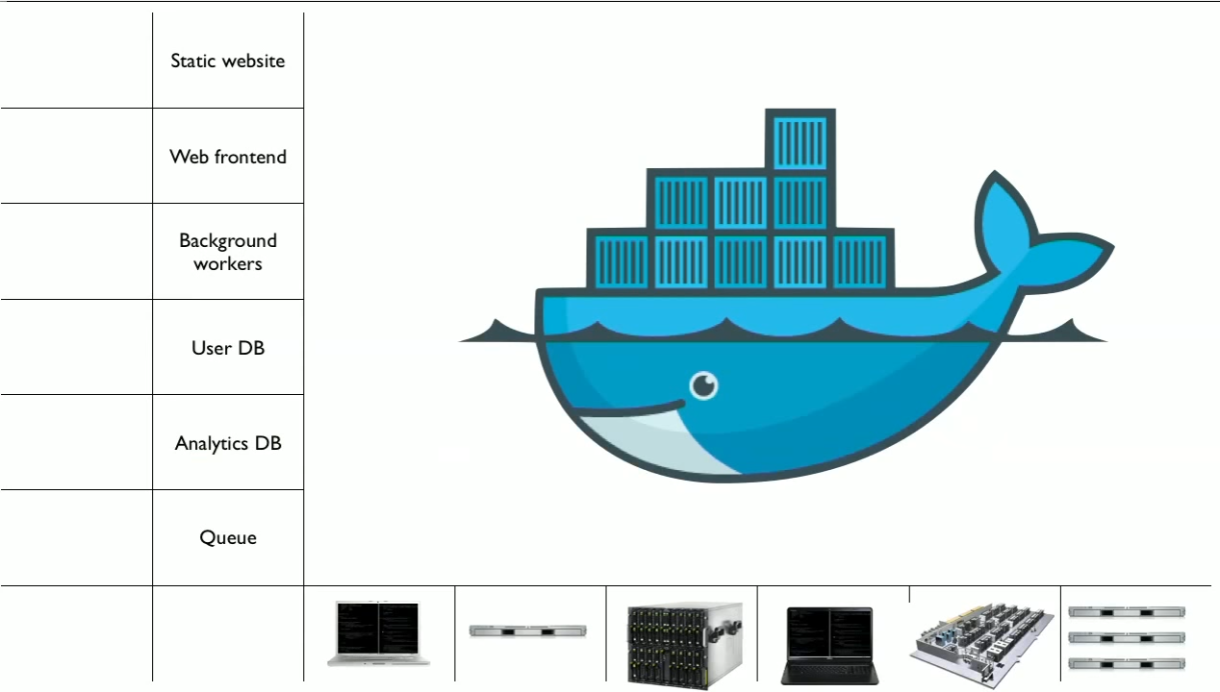
https://www.docker.com

Slide 10
Docker
Isolation
Lightweight
Simplicity
Workflow
Community

Slide 11
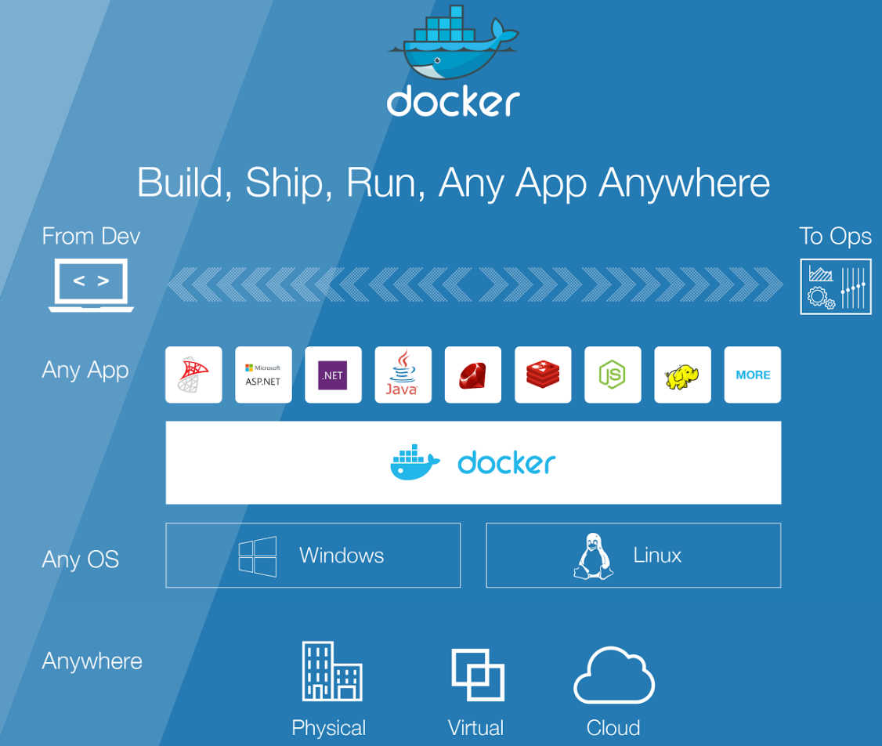
https://www.docker.com

Slide 12
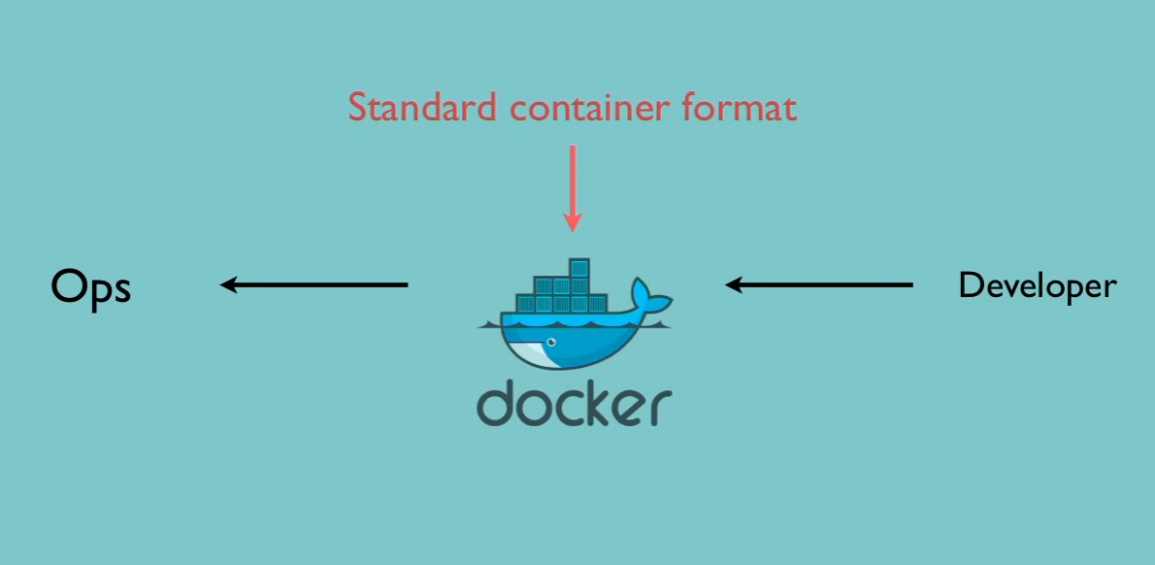
DevOps

Slide 13
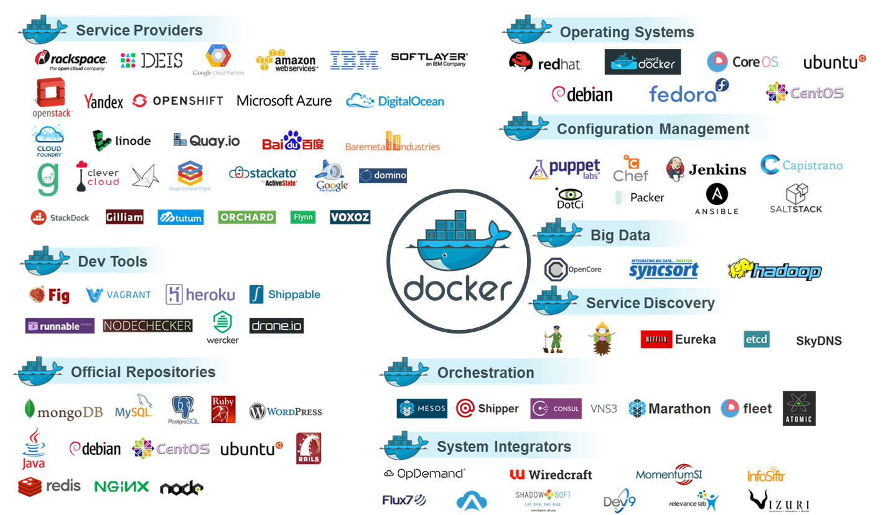
Docker Ecosystem
https://www.docker.com

Slide 14
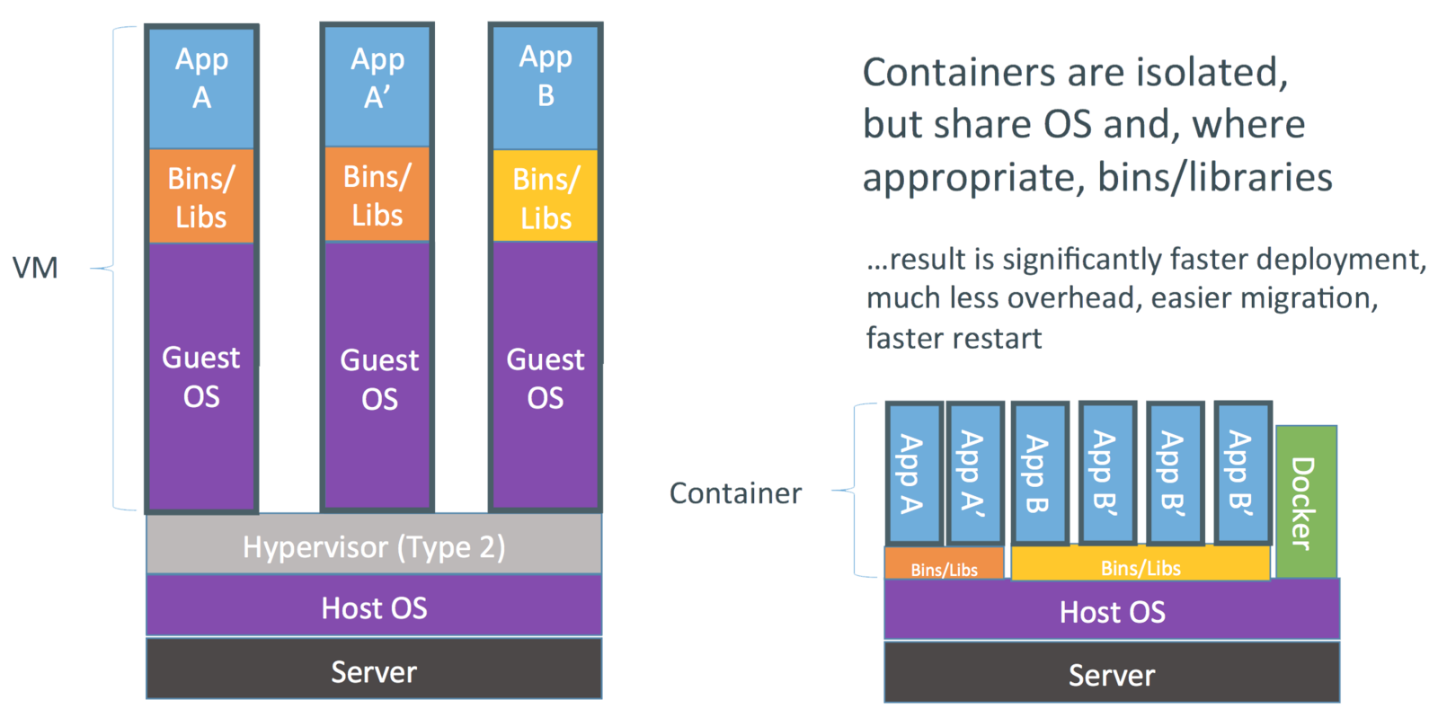
Containers vs. VMs
https://dzone.com/articles/evolution-of-linux-containers-future

Slide 15
Container vs. VM
 | VM | Container
Cost (Azure price) | 100% | 76%
DISK IO (Fio: Random R/W) | 50K IOPS (100%) | 101K IOPS (202%)
TCP Stream | 6739.01 Mbps (100%) | 9412 Mbps (140%)
UDP Stream | 3153.04 Mbps (100%) | 3939.44 Mbps (125%)
TCP Request/Response | 10920.48 Trans. rate/sec (100%) | 16725.26 Trans. rate/sec (153%)
UDP Request/Response | 11495.63 Trans. rate/sec (100%) | 18623.71 Trans. rate/sec (162%)
Average boot time | 11.48 secs (100%) | 1.53 secs (13.3%)
Image size (Ubuntu 14.04) | 8 GB (100%) | 177 MB (2.2%)
HA/Cluster | Support | Support
Backup/Restore Image | Support | Support
Windows | Support | Support from Win2016
Linux | Support | Support

Slide 16
Basic Concept on Docker
Image
Read only
Container
Instance from image
Registry
The same concept as Git
Store image files

Slide 17
Registry
Pull
Image
Container
Run
OS
Software
Application

Slide 18
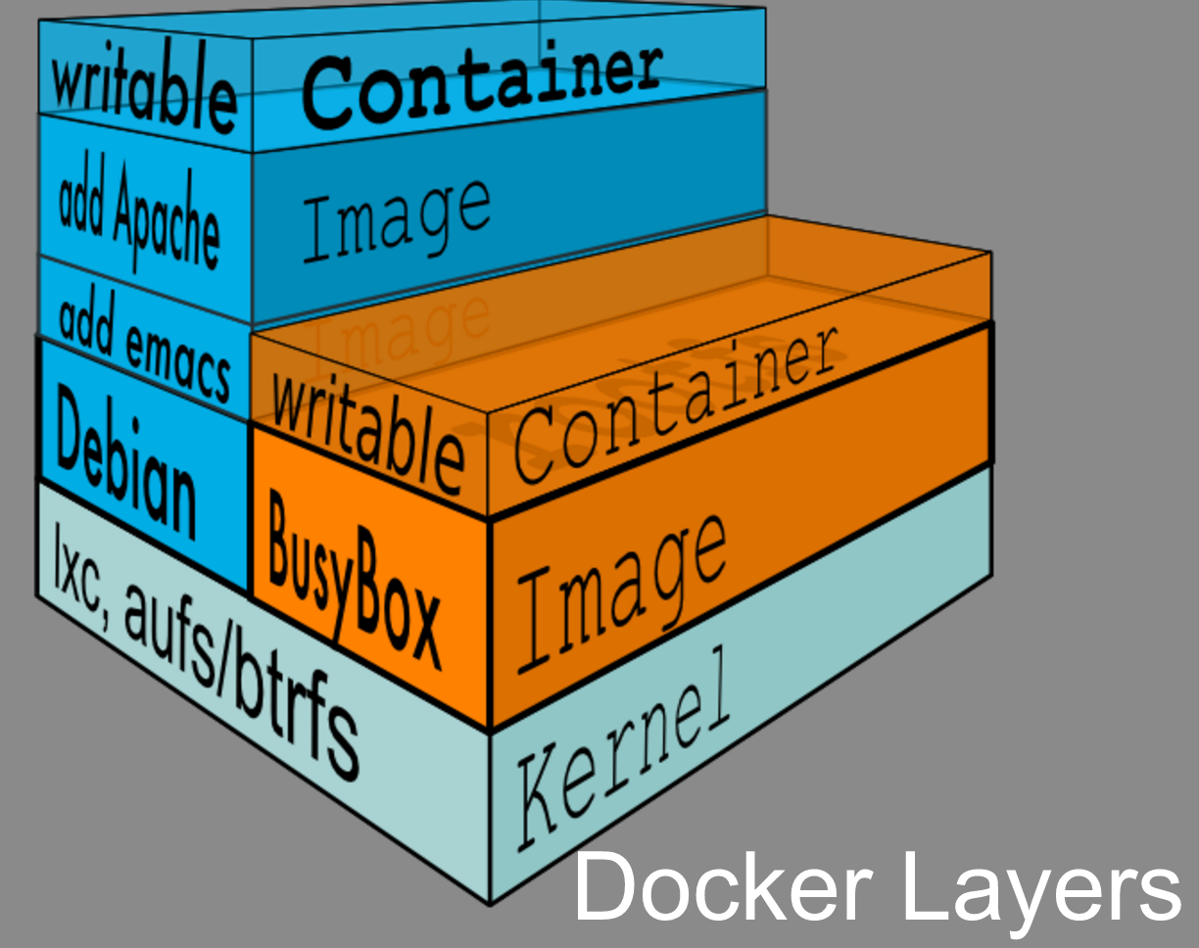
Source: https://docs.google.com/presentation/d/1pBBTzAbKAYTDXDE6ZDZzQkFKzFisMPQB8T96o1-N7po/pub?start=false&loop=false&delayms=3000&slide=id.g19613dd9d0_0_26

Slide 19
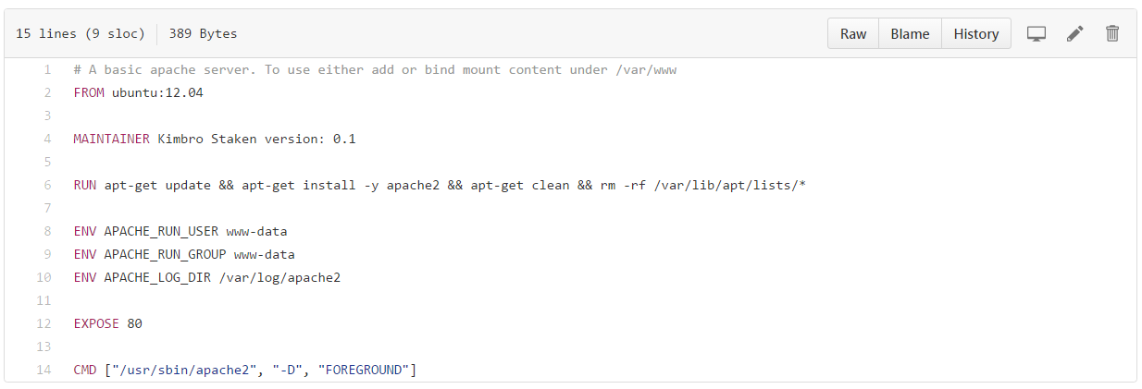
Dockerfile
A text document that contains all the commands a user could call on the command line to assemble an image
https://github.com/kstaken/dockerfile-examples/blob/8bef622c21d41bed53c826b8a9a1813455d5addc/apache/Dockerfile

Slide 20
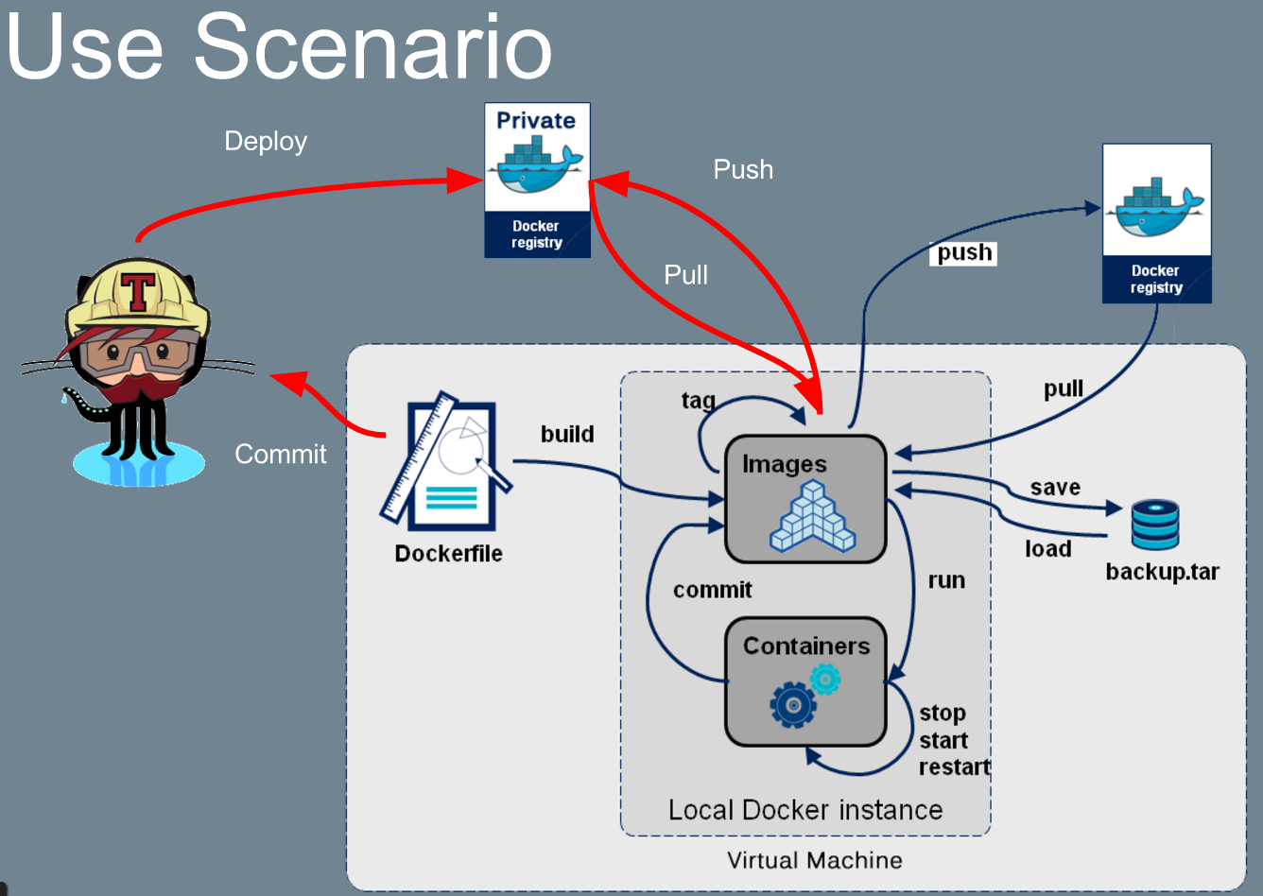
https://docs.google.com/presentation/d/1pBBTzAbKAYTDXDE6ZDZzQkFKzFisMPQB8T96o1-N7po/pub?start=false&loop=false&delayms=3000&slide=id.g19613dd9d0_0_541

Slide 21
Volume in Docker
Data volume
A specially-designated directory within one or more containers that bypasses the Union File System
Features
Initialized when a container is created
Shared and reused among containers
Data volumes persist even if the container itself is deleted

Slide 22
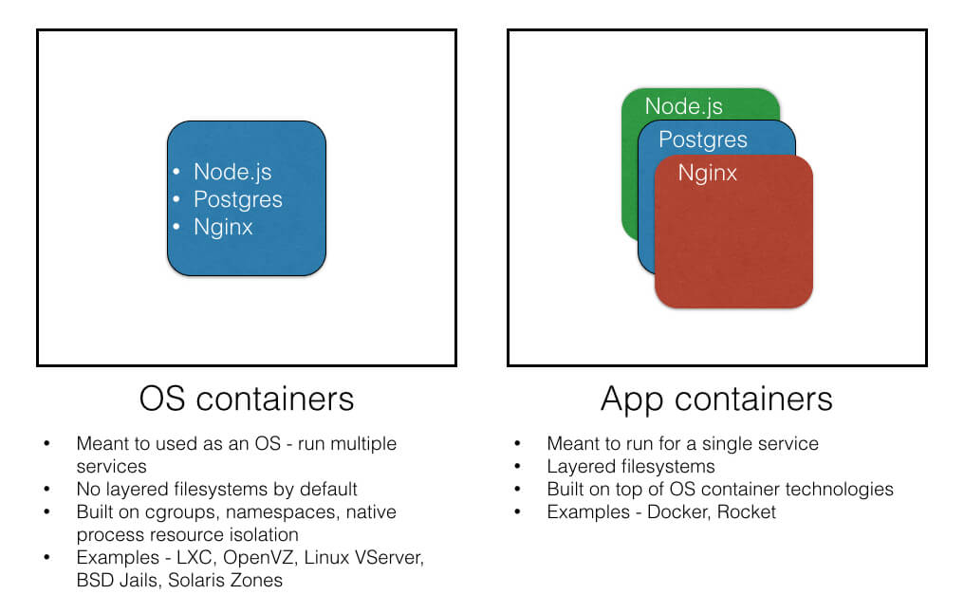
OS Container vs. App Container
https://blog.risingstack.com/operating-system-containers-vs-application-containers/

Slide 23

Hitler uses Docker

Slide 24
Introduction to Kubernetes
Mac Chiang

Slide 25
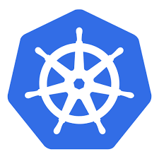
What’s Kubernetes
“Kubernetes” is Greek for captain or pilot
Experiences from Google and design by Goolge
Kubernetes is a production-grade, open-source platform that orchestrates the placement (scheduling) and execution of application containers within and across computer clusters.
Masters manage the cluster and the nodes are used to host the running applications.
Notes:
https://kubernetes.io/docs/tutorials/kubernetes-basics/cluster-intro/

Slide 26
Why Kubernetes
Automatic binpacking
Horizontal scaling
Automated rollouts and rollback
Service monitor
Self-healing
Service discovery and load balancing
100% Open source, written in Go

Slide 27
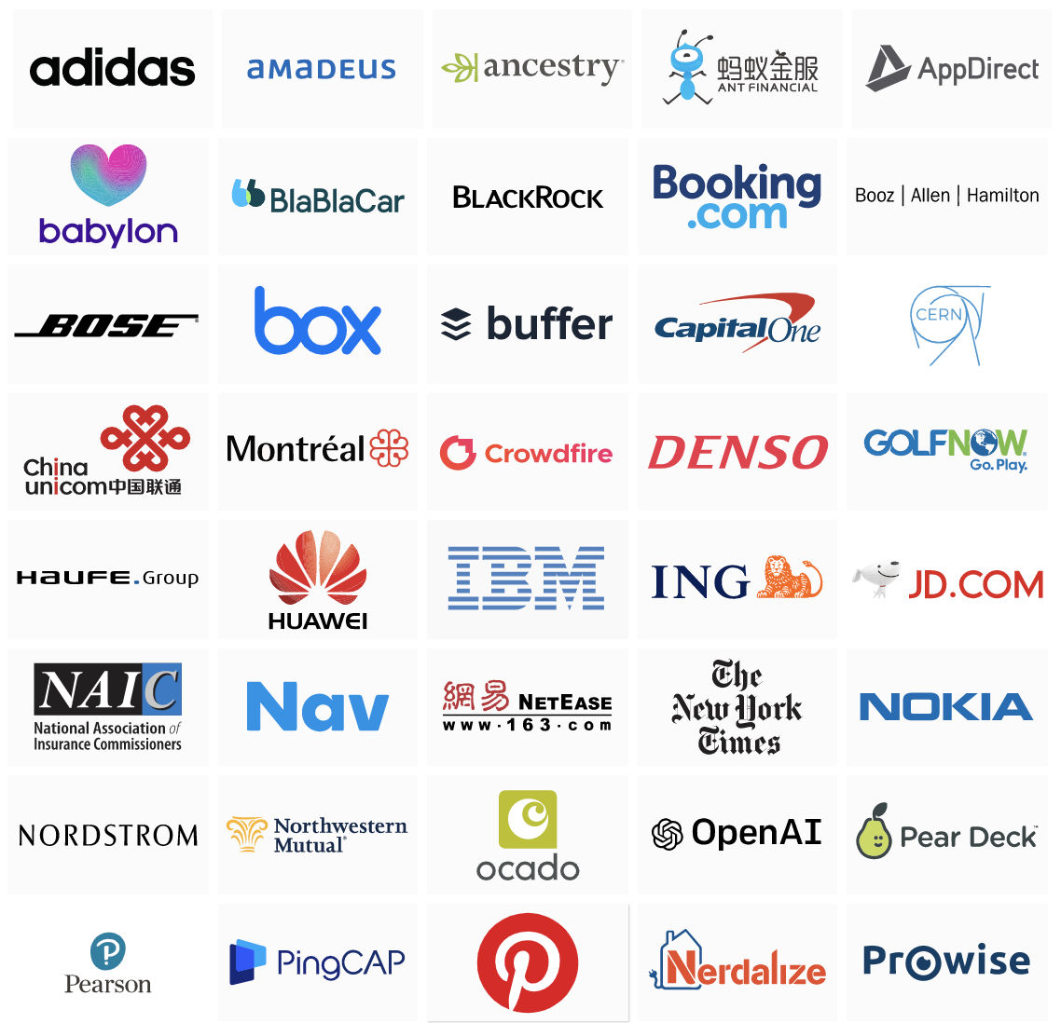
Who use Kubernetes
https://kubernetes.io/case-studies/

Slide 28
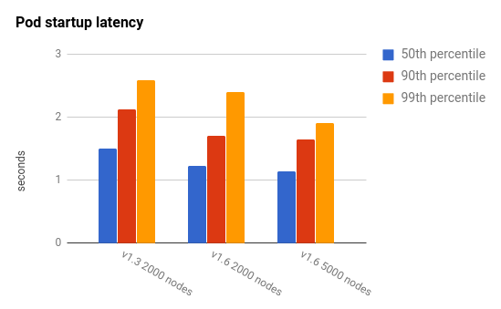
Kubernetes 1.6 Scalability Update
5,000 node and 150,000 pod clusters
https://twitter.com/kubernetesio/status/847482499785609216?s=20

Slide 29
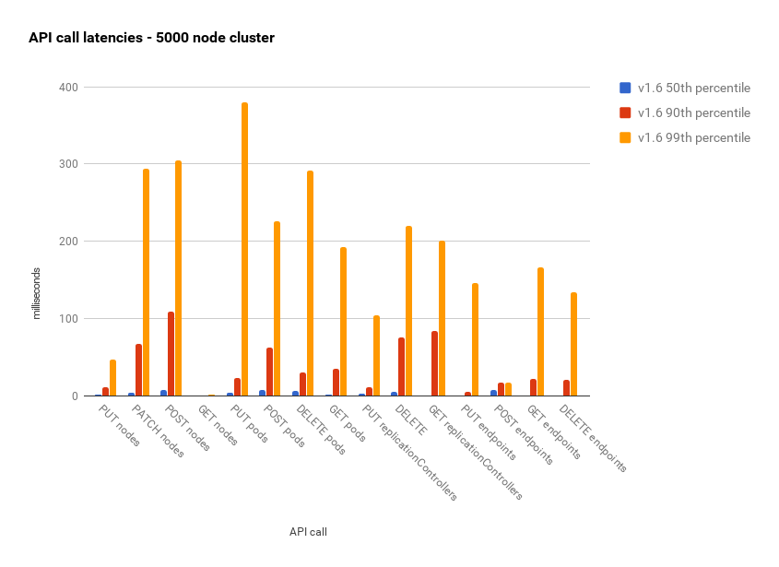
Kubernetes 1.6 Scalability Update (cont.)
API response latency for a 5000-node Kubernetes 1.6 cluster are less than 500ms, and even 90th percentile is less than about 100ms
https://blog.csdn.net/qq_34463875/article/details/71171927

Slide 30
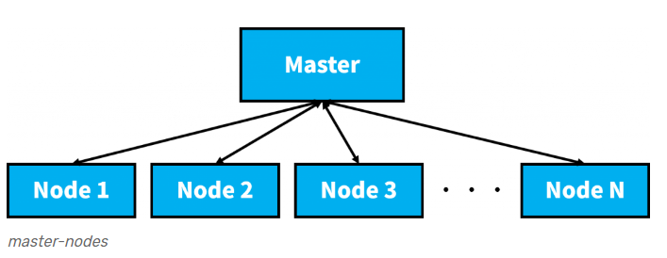
Kubernetes Architecture

Slide 31
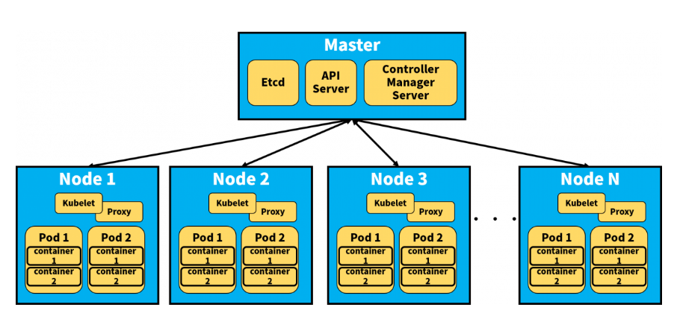
Kubernetes Architecture (cont.)

Slide 32
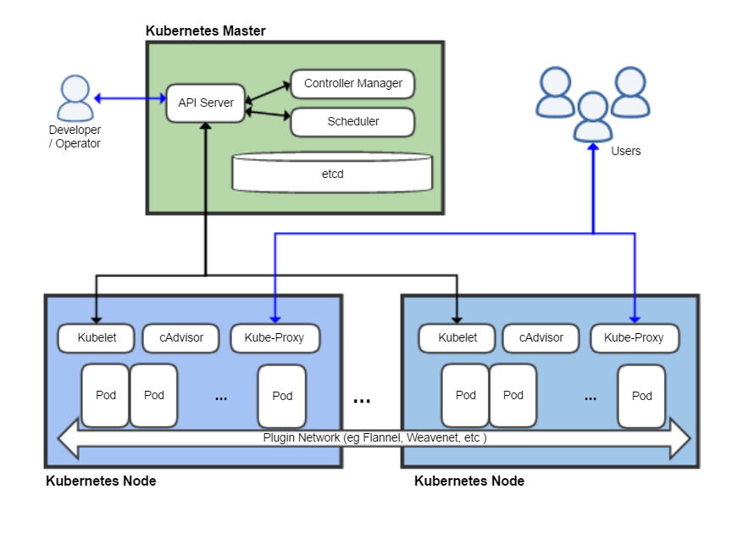
Kubernetes Architecture (cont.)
https://www.jobacle.nl/?p=2688

Slide 33
Kubernetes Components
Master Node
kube-apiserver
exposes the Kubernetes API
kube-controller-manager
A binary that runs controllers, which are the background threads that handle routine tasks in the cluster
etcd
used as Kubernetes’ backing store
kube-scheduler
watches newly created pods that have no node assigned, and selects a node for them to run on.
Addons
created in the “kube-system” namespace
Notes:
https://kubernetes.io/docs/concepts/overview/components/

Slide 34
Kubernetes Components (cont.)
Node
kubelet
the primary node agent
kube-proxy
enables the Kubernetes service abstraction by maintaining network rules on the host and performing connection forwarding
docker
dused for actually running containers.
rkt
rkt is supported experimentally as an alternative to docker.
Notes:
https://kubernetes.io/docs/concepts/overview/components/

Slide 35
kube-controller-manager
Node Controller
Responsible for noticing & responding when nodes go down
Replication Controller
Responsible for maintaining the correct number of pods for every replication controller object in the system
Endpoints Controller
Populates the Endpoints object (i.e., join Services & Pods)
Service Account & Token Controllers
Create default accounts and API access tokens for new namespaces

Slide 36
kubelet
Watches for pods that have been assigned to its node
Mounts the pod’s required volumes
Downloads the pod’s secrets
Runs the pod’s containers via docker
Periodically executes any requested container liveness probes
Reports the status of the pod back to the rest of the system, by creating a “mirror pod” if necessary.
Reports the status of the node back to the rest of the system.

Slide 37
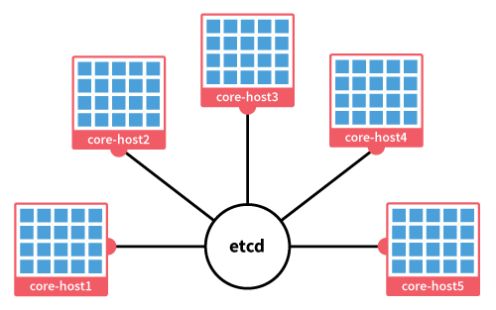
etcd
Distributed key, value store
Used for configuration and monitoring store
Used for Service discovery
JSON/REST API
https://alankent.files.wordpress.com/2014/09/etcd.png

Slide 38
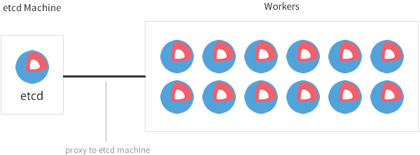
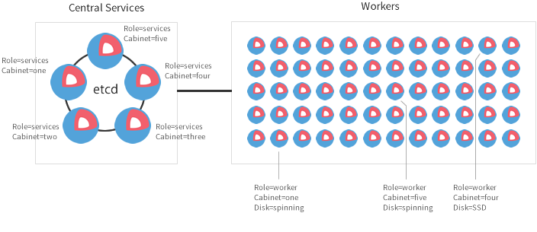
Deploy etcd Cluster
Multi-Node/Production
Single-Node/Development
https://coreos.com/os/docs/latest/cluster-architectures.html

Slide 39
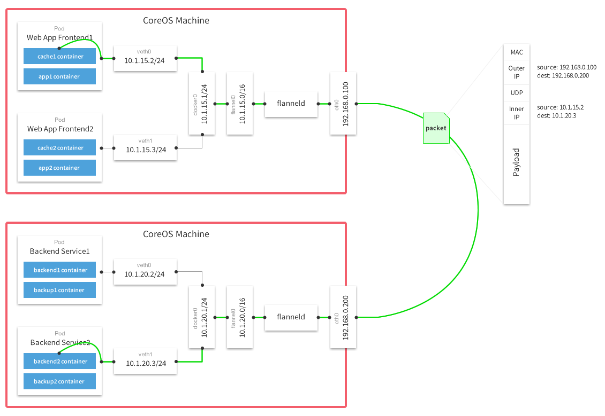
flannel
A virtual network that gives a subnet to each host for use with container runtimes
https://elatov.github.io/2017/10/using-flannel-with-coreos/

Slide 40
The Key Concept
Pod
Smallest deployable unit
Shared context
Service
Targets pods
Long-lived
Deployment (Replication controller)
Ensure N pods are running
Pod template
Label
Key/value pair
Organize, select objects

Slide 41
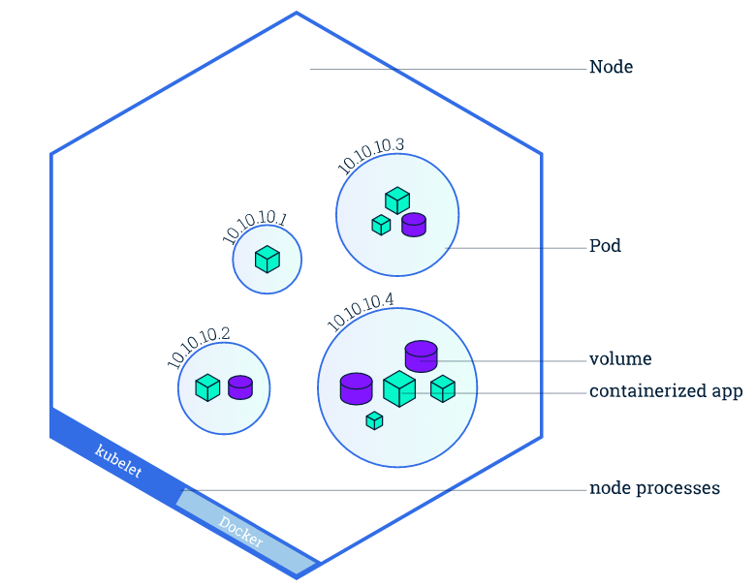
Nodes
A node is a worker machine in Kubernetes and may be a VM or physical machine
Multiple Pods can run on one Node
https://kubernetes.io/

Slide 42
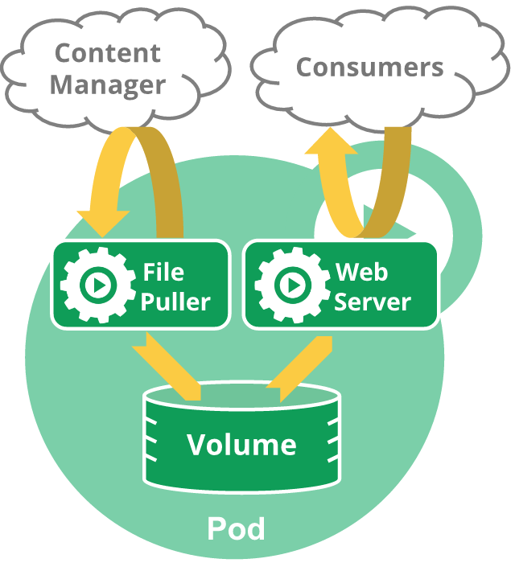
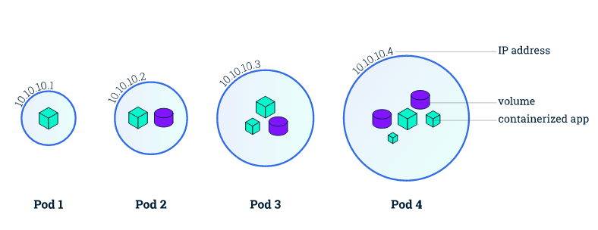
Pods
A group of one or more containers
Containers within a pod share IP, port, namespaces and volumes.
https://kubernetes.io/
Notes:
https://kubernetes.io/docs/concepts/workloads/pods/pod/
in a pre-container world, they would have executed on the same physical or virtual machine.

Slide 43
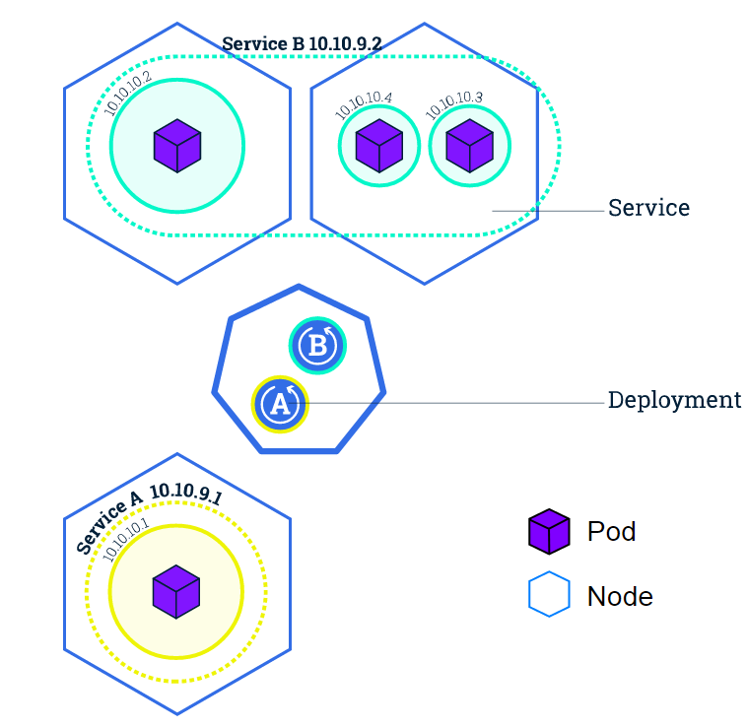
Service
A Service is an abstraction which defines a logical set of Pods and a policy by which to access them
Persistent
Routes traffic across a set of Pods
Provide load balancer
Provide discovery
Provide stable service address
Find pods by label selector
https://kubernetes.io/
Notes:
https://kubernetes.io/docs/tutorials/kubernetes-basics/expose-intro/

Slide 44
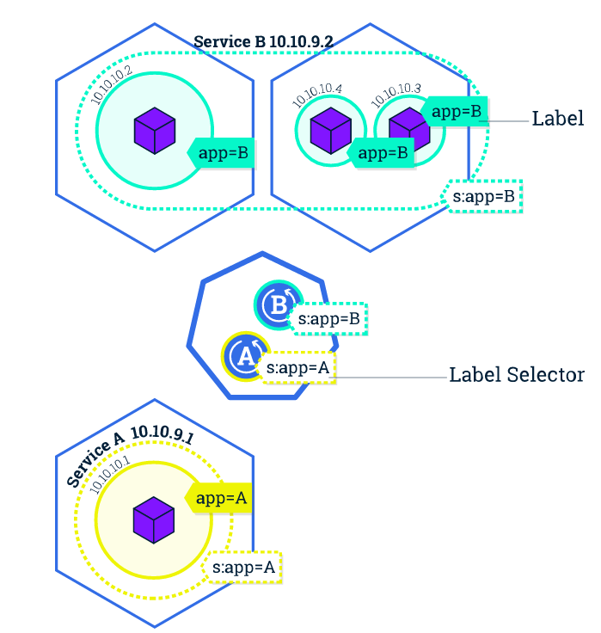
Label
Metadata with sematic meaning
Label selector
Set of objects
https://kubernetes.io/

Slide 45
Deployment (Replication Controller)
Provides declarative updates for Pods and ReplicaSets
Rollout/ Roll back a ReplicaSet
Scale up the deployment

Slide 46
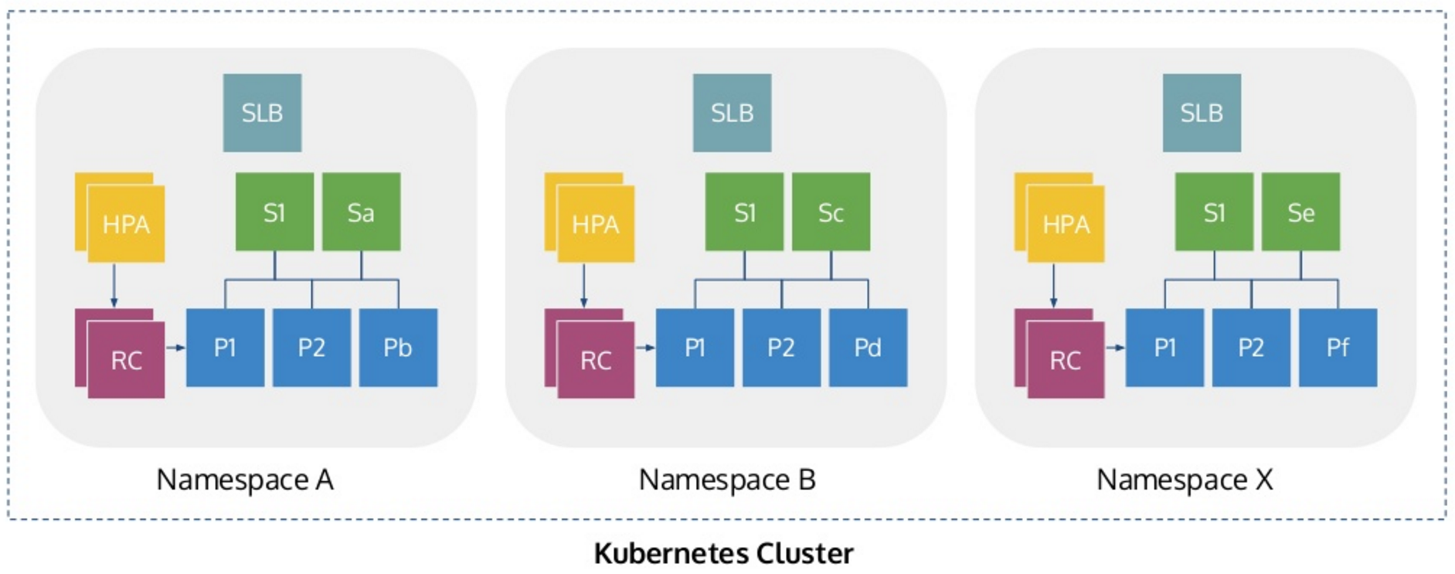
Namespace
Group + segment pods, rcs, volumes and secrets from each other
https://www.slideshare.net/imesh/multitenancy-in-c5

Slide 47
Annotations
Annotations are not used to identify and select objects
Use Case
Default/auto-generated configuration
Build, release, or image information like timestamps, release IDs, git branch, PR numbers, image hashes, and registry address.
Phone or pager numbers of persons responsible
Directory entries that specify where that information can be found, such as a team web site.
"annotations":
{ "key1" : "value1",
"key2" : "value2" }
Notes:
https://kubernetes.io/docs/concepts/overview/working-with-objects/annotations/

Slide 48
Kubernetes YAML
YAML file describes the required fields and object spec for Kubernetes
apiVersion: apps/v1
kind: Deployment
metadata:
name: nginx-deployment
spec:
replicas: 3
template:
metadata:
labels:
app: nginx
spec:
containers:
- name: nginx
image: nginx:1.7.9
ports:
- containerPort: 80
apiVersion
Which version of the Kubernetes API you’re using to create this object
kind
What kind of object you want to create
metadata
Data that helps uniquely identify the object, including a name string, UID, and optional namespace
Notes:
https://kubernetes.io/docs/concepts/overview/working-with-objects/kubernetes-objects/

Slide 49

The Illustrated Children's Guide to Kubernetes
http://www.bilibili.com/video/av10087636/

Slide 50
Deploy on bare metal or cloud?
Bare metal
Hardware can’t support virtualization
CPU Model: Dual Core AMD Opteron(tm) Processor 270
Better performance
Bare metal vs. VM
Cloud
Well integrated with networking and storage

Slide 51
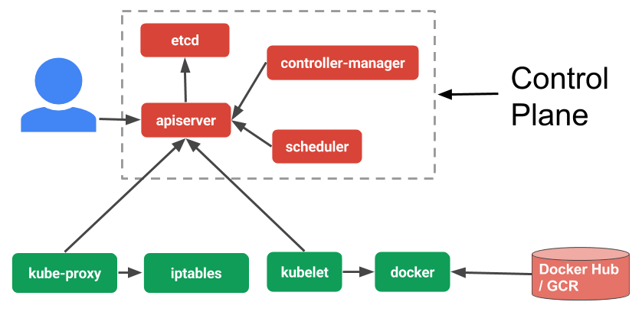
What’s kubeadm?
An deployment tool that simplified Kubernetes cluster installation flow
https://www.ianlewis.org/en/how-kubeadm-initializes-your-kubernetes-master
Notes:
https://www.ianlewis.org/en/how-kubeadm-initializes-your-kubernetes-master

Slide 52
Installing Kubernetes on Linux with kubeadm
Install Ubuntu 16.04+ or CentOS 7+
Swap disabled
Installing kubelet and kubeadm on your hosts
Initializing your master
Installing a pod network
Joining your nodes
Notes:
https://kubernetes.io/docs/getting-started-guides/kubeadm/

Slide 53
Installing kubelet and kubeadm on your hosts
Install the following packages on all the machines
Docker
the container runtime
Kubelet
the most core component of Kubernetes
Kubectl
the command to control the cluster once it’s running
Kubeadm
the command to bootstrap the cluster

Slide 54
Initializing your master
Run a series of pre-flight checks
Generate tokens
Generates a self-signed CA
Outputting a kubeconfig file for the kubelet and an additional kubeconfig file for administration.
Generates Kubernetes Static Pod manifests for the API server, controller manager and scheduler.
Run control plane components on master node
Sets up the RBAC authorization system and writes a special ConfigMap for kubelets trust
Installs add-on components via the API server
DNS server and the kube-proxy DaemonSet
kubeadm init --pod-network-cidr 10.244.0.0/16

Slide 55
Installing a pod network (kube-router)
kubectl apply -f https://raw.githubusercontent.com/cloudnativelabs/kube-router/master/daemonset/kubeadm-kuberouter.yaml

Slide 56
Installing a pod network (flannel)
kubectl apply --namespace kube-system -f https://raw.githubusercontent.com/coreos/flannel/master/Documentation/kube-flannel.yml

Slide 57
Installing a pod network (weave)
kubectl apply -n kube-system -f \
"https://cloud.weave.works/k8s/net?k8s-version=$(kubectl version | base64 | tr -d '\n')"

Slide 58
Joining your nodes
Install Ubuntu 16.04+ or CentOS 7+
Swap disabled
Installing kubelet and kubeadm on your hosts
Downloads root CA information from the API server
Creates a local key pair
Configures the local kubelet to connect to the API server
kubeadm join --token <token> <master-ip>:<master-port>

Slide 59
Guestbook Example
This example shows
How to build a simple multi-tier web application using Kubernetes and Docker
The application consists of
A web front-end
Redis master for storage,
Replicated set of Redis slaves
Use Kubernetes
deployments and services
https://github.com/kubernetes/examples/tree/master/guestbook

Slide 60



Guestbook Architecture
frontend
frontend
Service
redis-master
Service
redis-slave
Service
redis-master
redis-slave
Notes:
The redis master in this example is not highly available

Slide 61
From Docker to Kubernetes
Docker vs Kubernetes = Apple vs Apple Pie
Application Encapsulation to Container Orchestration
Replace Docker with Kubernetes?
The best learning resource
https://kubernetes.io/docs/home/

